Slide 1

BUILDING A MODEL TO PREDICT Churners

Slide 2

GROUP 6- TEAM MEMBERS
STUDENT NAME | STUDENT ID
Amruth Raj Manchikanti | 500236389
Riya Shah | 500236809
Nitish Janagam | 500236390
Neha Tamang | 500239325
Stephen David Chitilapalli Mathew | 500231708
Saurav Risal | 500237418
Jeffin John Abraham | 500238905
Sumith Padma Padmasree Vijayapadman | 500237168
Anirudhra Budhatoki | 500236947

Slide 3
INTRODUCTION
Customers usually change the bank for better services.
Some customers churn to the previous banks.
Our Objectives:
Analyze and Pre-process the data
Implement and evaluate different machine learning models
Identification of customers who will churn or not.

Slide 4
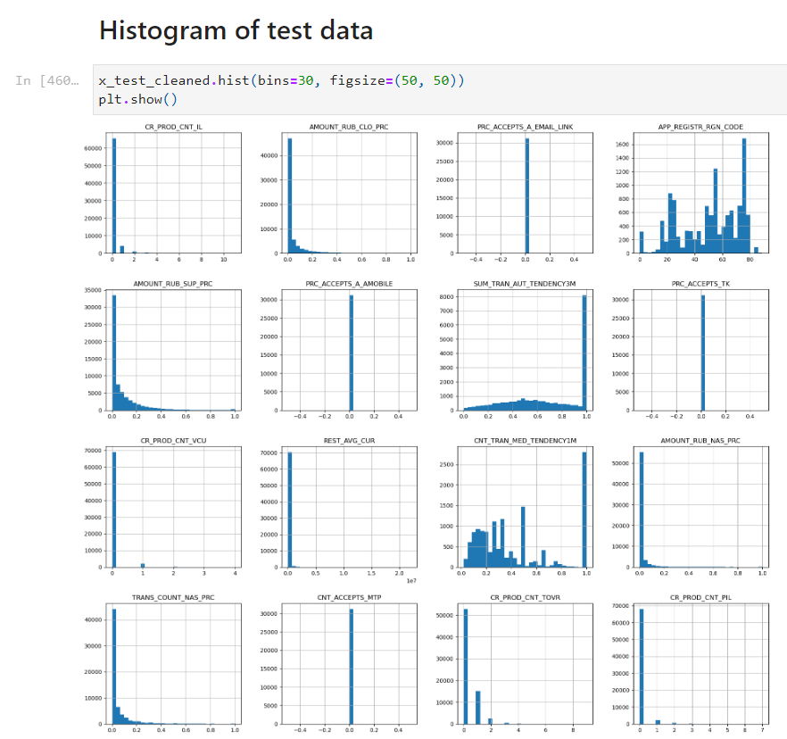
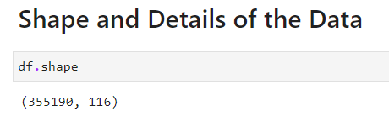
EDA & DATA PREPROCESSING
Original datasets were imported.
Original Dataset has shape of 355190 rows and 116 Columns
Dropped values with more than 95% null.
The data was splitted into Train and Test sets,later the null values weredropped from them and checked for outliers in both Train and Test sets.
Most Frequent Category of Categorical imputation was used to replace the frequently occurred category with Null.
The Due to imbalanced data we used SMOTE technique to address the issue particularly in classification.
The data was split into train and test with 4:1 ratio before the further processing is done.

Slide 5
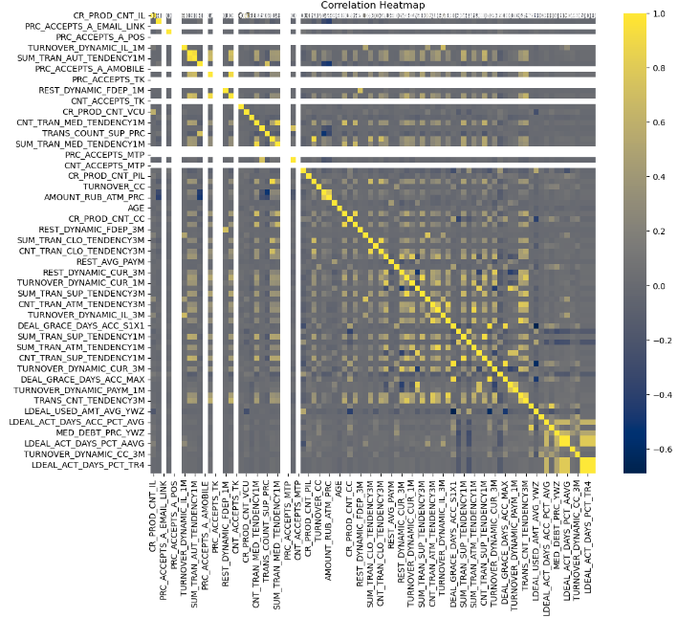
EDA & DATA PREPROCESSING Cont…
The Russian Text was translated into English in Google Sheets using the Google’s GOOGLETRANSLATE formula.
To check the impact of null values, we have printed out the number of Targets with 0 and 1 cases for each feature when the values are null and when the values are not null.
We have then dropped the values that have more than 95% of the data as null values
As the dataset given was very imbalanced with more 0s than 1s in the target variables. We down-sampled the majority class to 2:1 ratio for the training data.
To reduce the size of dataset, we have randomly picked 5000 samples for the training data and 1000 samples for the test data.

Slide 6
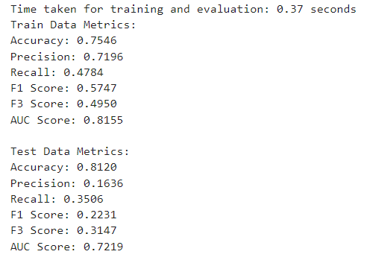
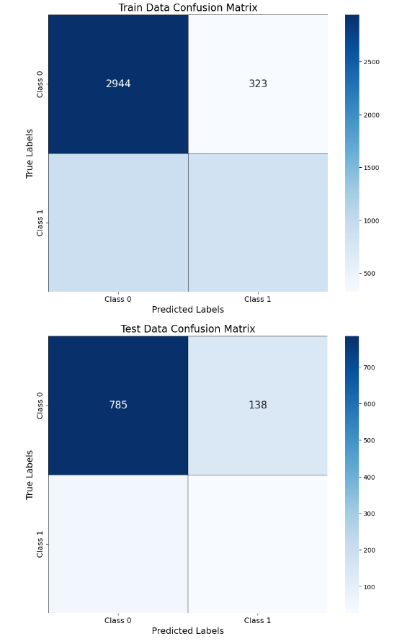
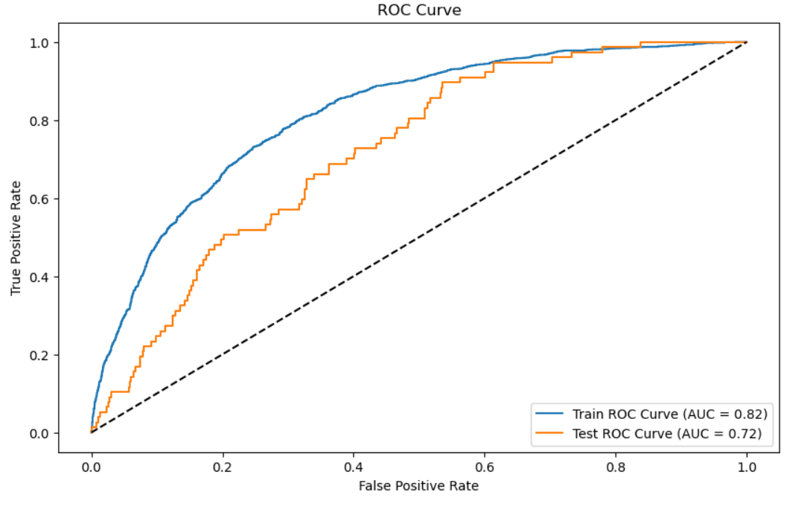
Logistic Regression
Data preprocessing using OneHotEncoder
Performance metrics were evaluated.
Accuracy
Precision
Recall
F1 scores and F3 scores
Visualization was done.
ROC Curve
AUC Score
Confusion Matrix

Slide 7
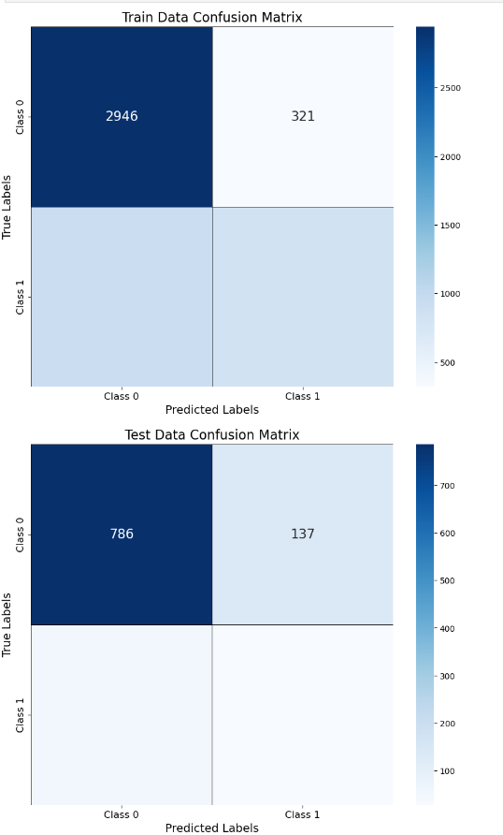
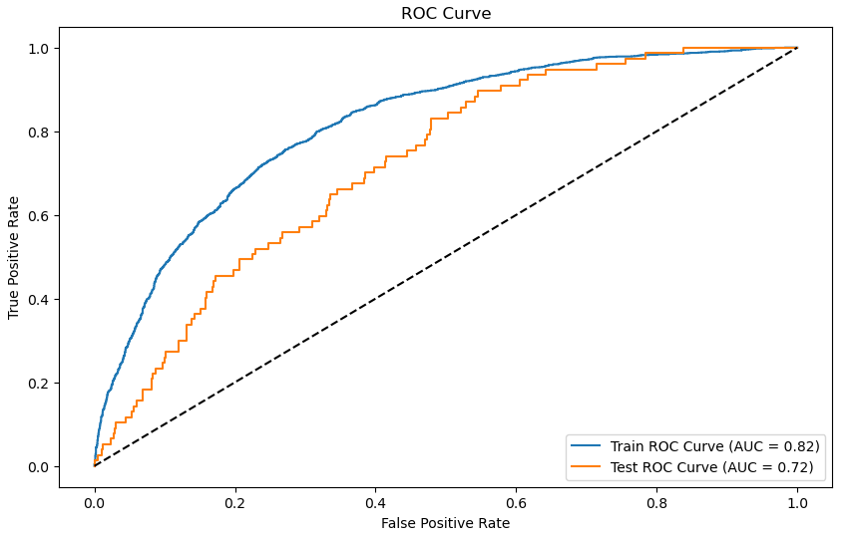
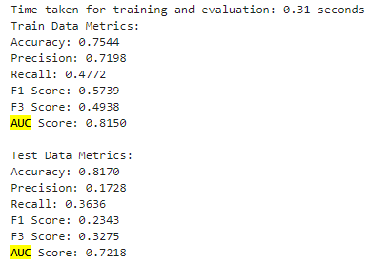
Sensitivity Analysis
Performed using Logistic Regression
Identified features with low contribution
Removed features with sensitivity scores < 0.00005
Results showed minimal impact on model performance

Slide 8
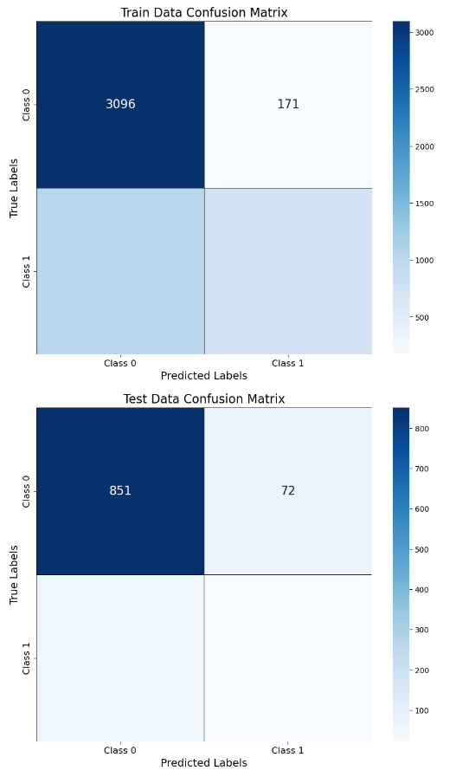
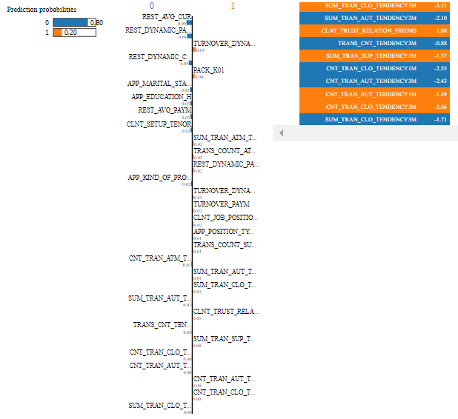
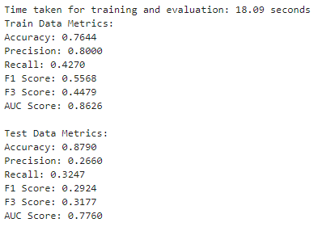
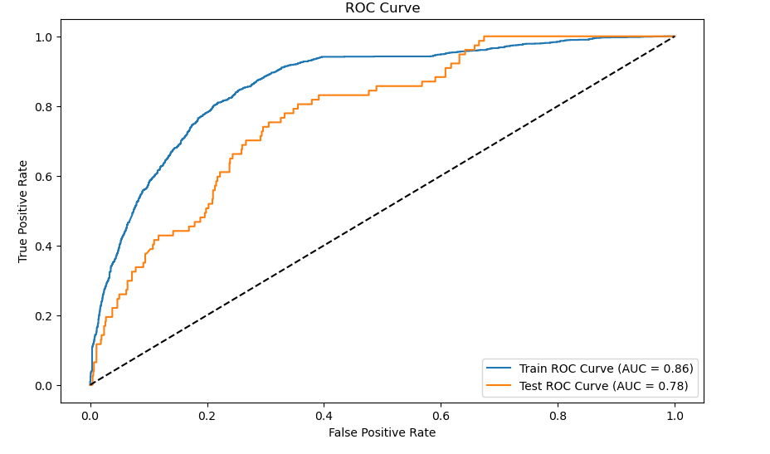
SVM
Implemented SVM on the refined dataset
Performance metrics were calculated:
ROC curve for train and test data
Confusion Matrix
Model balanced for both classes in test data
We then performed LIME to find out the most important features for the model.
The three most important features are:
SUM_TRAN_CLO_TENDENCY1M: 3.13
SUM_TRAN_AUT_TENDENCY3M: 2.10
CNT_TRAN_CLO_TENDENCY3M: 2.66

Slide 9
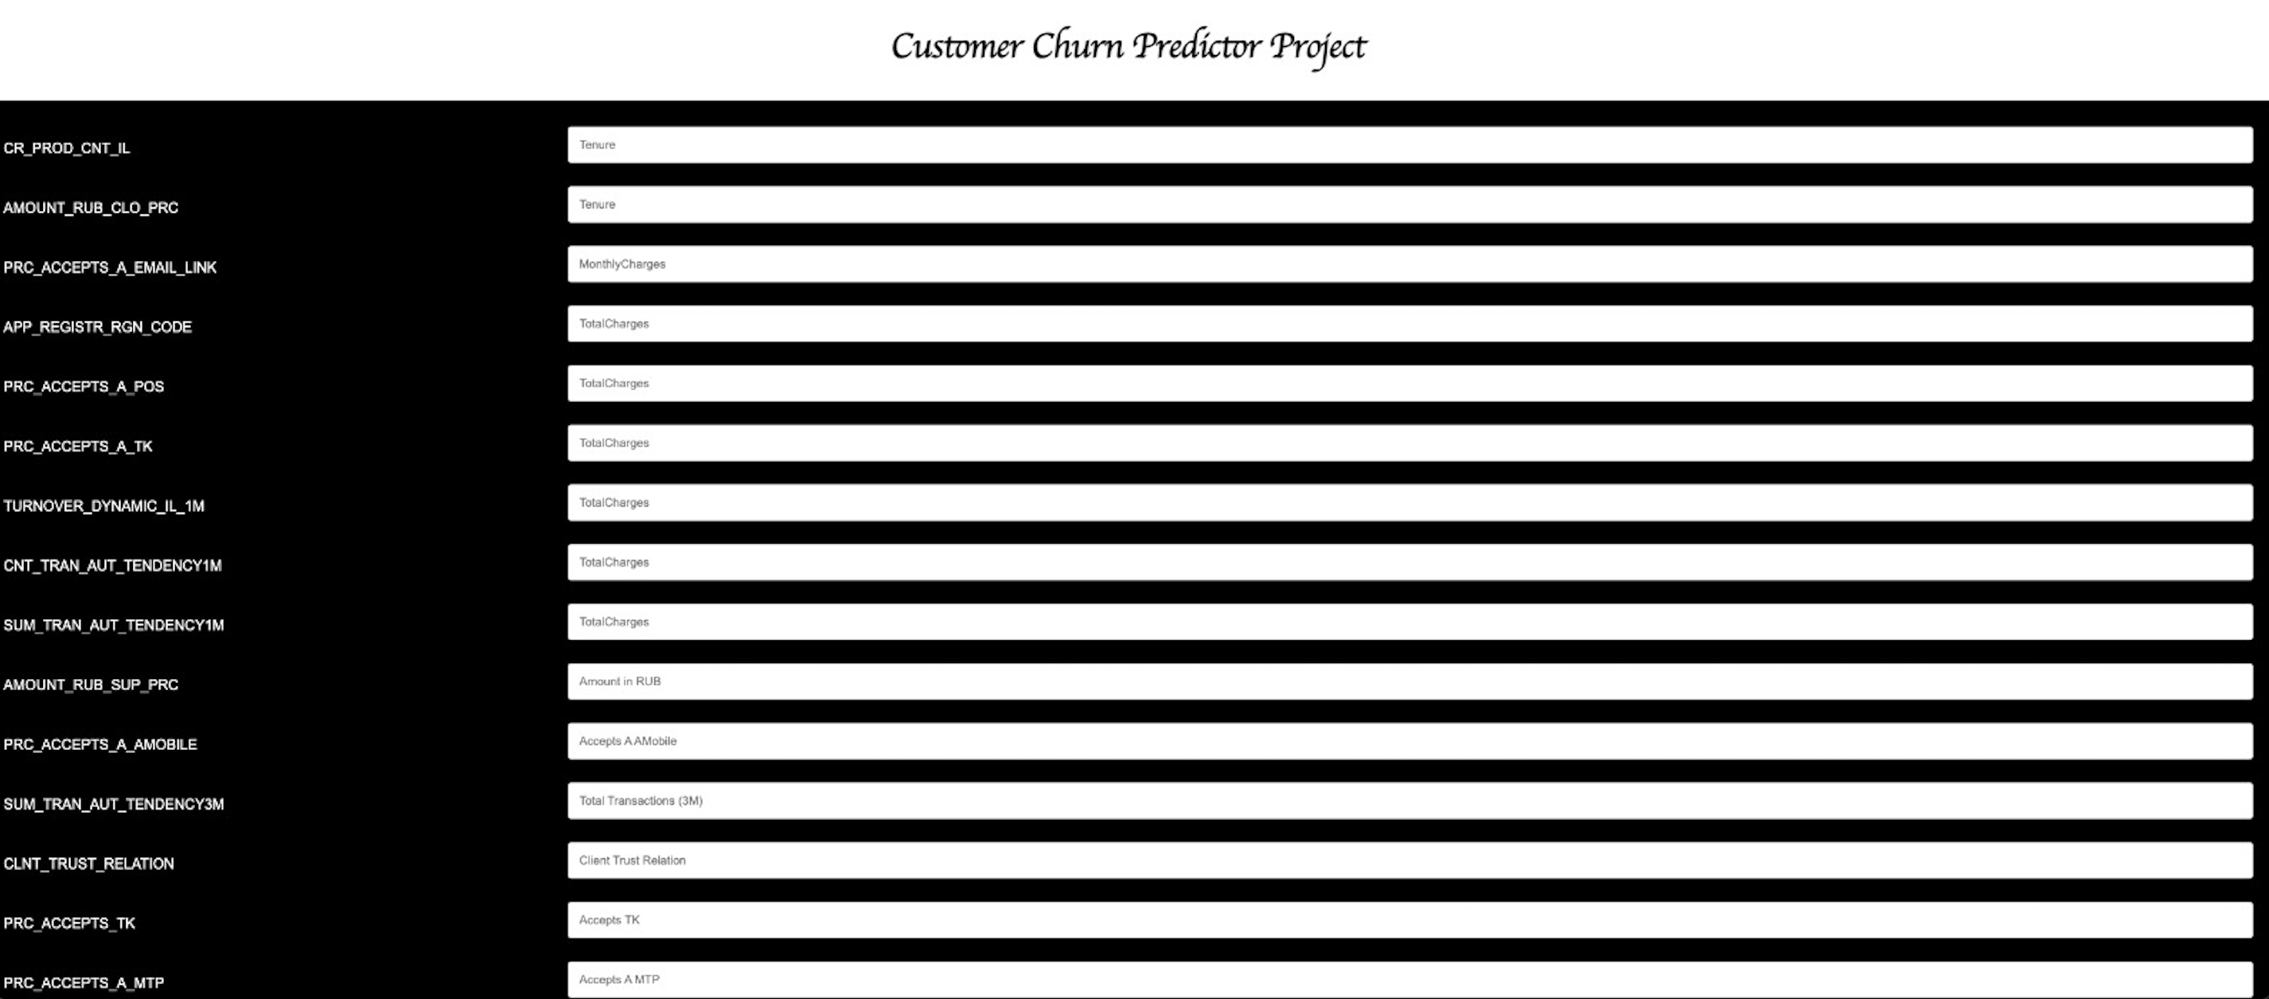
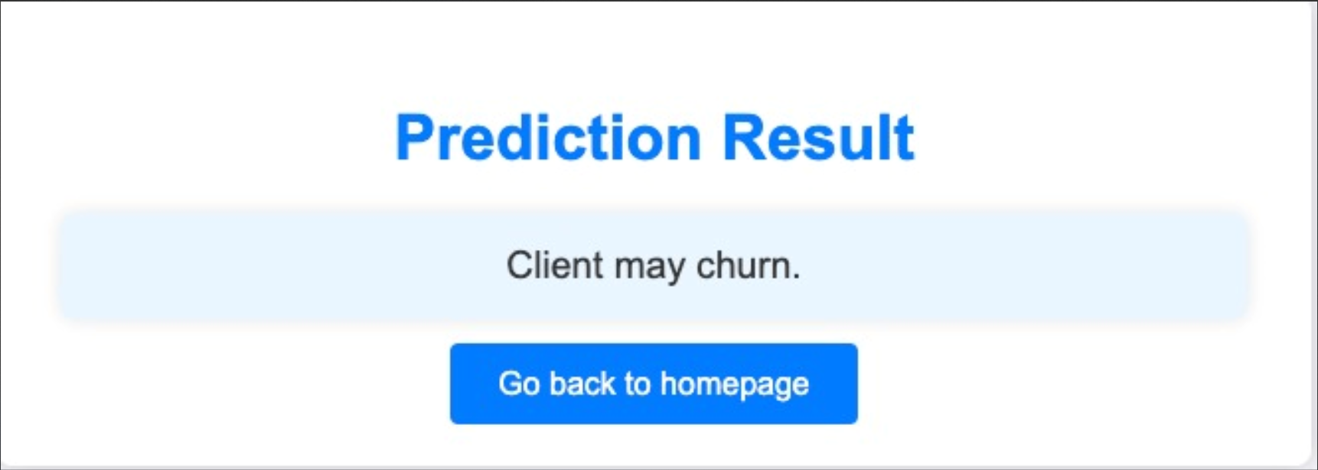
Deployment
Design Features
User-Centric Interface:
The form features a clean and modern design to ensure ease of use and accessibility.
Font choice and styling provide readability and a professional appearance.
Responsive Design:
The layout adapts to different screen sizes, making it accessible on various devices including desktops, tablets, and smartphones.
Intuitive Layout:
The form is organized in a straightforward manner, with clear labels and input fields to facilitate smooth user interaction.
Alternating background colors for form groups enhance readability and visual separation of different sections.

Slide 10
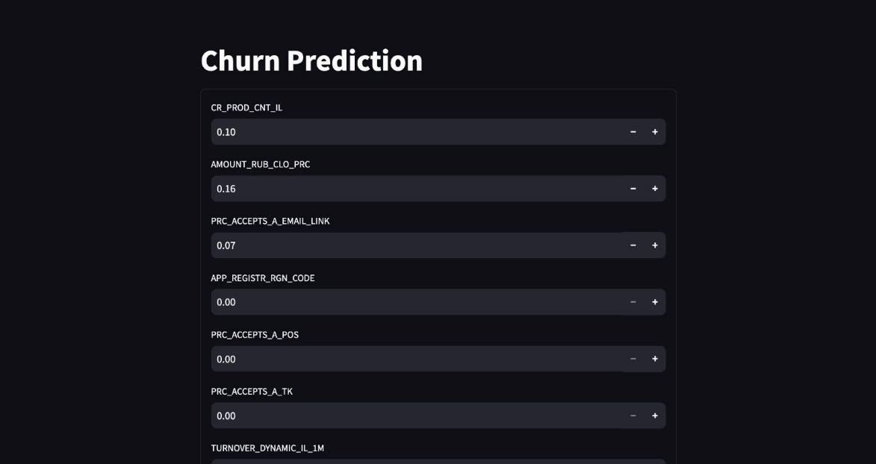
Metrics Breakdown
CR_PROD_CNT_IL:
Represents the count of products a customer has.
A higher count may indicate higher customer engagement and lower churn risk.
AMOUNT_RUB_CLO_PRC:
Denotes the amount of money in rubles closed in a specific period.
Helps in understanding the financial behavior of customers.
3 . PRC_ACCEPTS_A_EMAIL_LINK:
Percentage of customers who accept communication via email links.
Indicates customer preference for digital communication, impacting retention strategies.
4. APP_REGISTR_RGN_CODE:
Application registration region code.
Useful for regional analysis of churn patterns.
5. TURNOVER_DYNAMIC_IL_1M:
Turnover dynamics over one month.
Reflects the recent activity and engagement level of the customer.

Slide 11
Conclusion and Future Work
From the initial data we found:
The AUC score, accuracy and precision value of the provided data increased with SVM then without doing SVM for both train and test data
The AUC score, accuracy and precision value of the provided data was similar to the model after doing logistic regression and sensitivity analysis
Future Work:
All the bank data and factor for the predicting chunks gets updated time to time and the things may be changed. So, the model needs to be recalculated with the updated factors

